Slide 1
CS1231 Tutorial 9
AY18/19 – WEEK 11
Andrew Tan

Slide 2
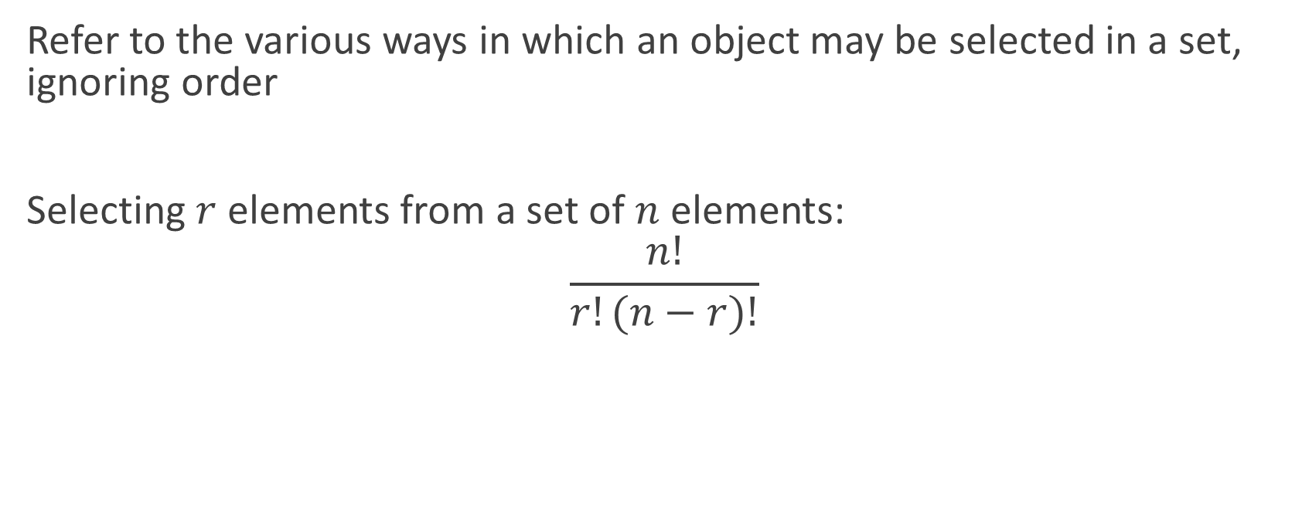
Combinations
Refer to the various ways in which an object may be selected in a set, ignoring order
Selecting $r$ elements from a set of $n$ elements:
$$\frac{n!}{r!(n−r)!}$$

Slide 3
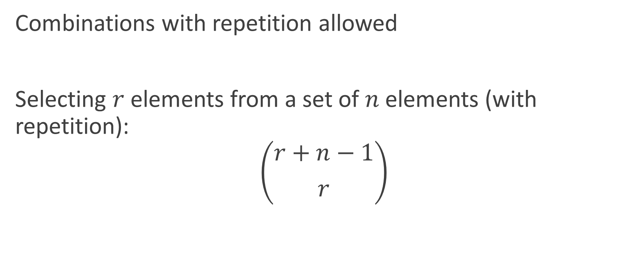
Multisets
Combinations with repetition allowed
Selecting $r$ elements from a set of $n$ elements (with repetition):
$$\left({r+n−1 \atop r}\right)$$

Slide 4
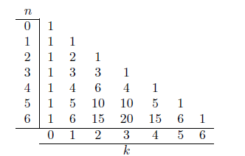

Pascal’s Formula
$$\left({n+1 \atop r}\right)=\left({n \atop r−1}\right)+\left({n \atop r}\right)$$

Slide 5

Binomial Theorem
Allows for the calculation for the powers of a binomial
${(a+b)}^{n}= \sum_{k=0}^{n}{\left({n \atop k}\right)a^{n−k}b^{k}}$

Slide 6
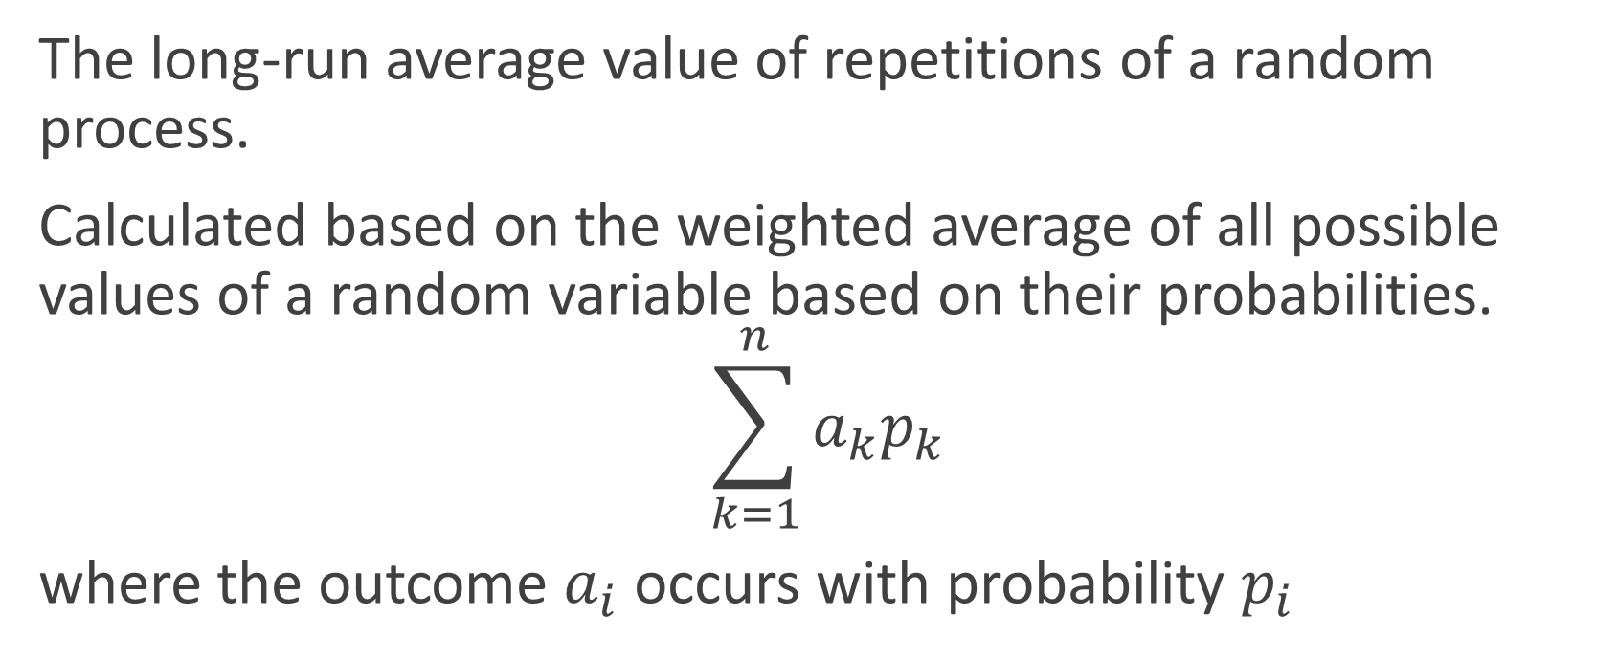
Expected value
The long-run average value of repetitions of a random process.
Calculated based on the weighted average of all possible values of a random variable based on their probabilities.
$$\sum_{k=1}^{n}{a_{k}p_{k}}$$
where the outcome $a_{i}$ occurs with probability $p_{i}$

Slide 7


Conditional Probability
The conditional probability of an event B given A, denoted $P(B|A)$ is

Slide 8

Bayes Theorem
Relates different conditional probabilities together

Slide 9
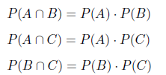

Pairwise independence
Three events are pairwise independent iff
And are mutually independent if the following is true as well:

